Slide 1

GKIDS Readiness Check Parent Information Guide
Notes:
Welcome to the Pre-Administration Training Part 1 for GKIDS and GKIDS Readiness Check.
Please enter any questions that you have in the Question box. The PPT for today’s presentation is available in the Handouts section.

Slide 2
Agenda
Purpose and Assessment Summary
  Readiness Check
Reports
Resources
Notes:
Review agenda
Many of you are concerned about administration of GKIDS and the Readiness Check in virtual environments. We plan to discuss this a little later in the presentation as well in our next session scheduled for August 13.

Slide 3
GKIDS 2.0 Readiness Check
The primary purpose of the GKIDS Readiness Check is to highlight knowledge and skills critical for student success in learning, solely to guide instruction. The Readiness Check:
  Is designed to be developmentally appropriate
  Provides information to allow kindergarten teachers to individualize instruction
  Informs our understanding of the skills of children entering kindergarten
  Provides information about the supports and resources needed to ensure every kindergarten student starts school with the skills needed to be successful
Notes:
We will begin our discussion today with the GKIDS 2.0 Readiness Check
Read slide

Slide 4
Assessment Development
Included input from Educators across Georgia
  Kindergarten teachers
  Department of Early Care and Learning (DECAL) representative
  Pre-K teachers
  Teachers with certification and experience with special education students and English learners
Reflects recommendations discussed during a review of student performance data following pilot and field test events
Notes:
The development cycle for Readiness check included – Read Slide

Slide 5
Assessment Design –
GKIDS Readiness Check
Aligned to the Georgia Early Learning and Development Standards (GELDS)
Consists of activities assessed using both direct (e.g., structured performance tasks) and indirect (e.g, observational) assessment methods.
Is accessible to all students at kindergarten entry, including students with disabilities and English learners
Is designed to be unobtrusive and naturalistic within the kindergarten setting.
Notes:
Read Slide

Slide 6
Readiness Check IS NOT
NOT intended to prevent children’s entry into kindergarten
NOT intended to evaluate teachers’ instruction
NOT intended to label students as not ready
NOT intended to be used as a high-stakes accountability measure
It is intended to guide and inform instruction.
Notes:
Defining the purpose of the Readiness Check is important, but there must also be an understanding of what it is NOT. And, we cannot stress this enough. We certainly understand how assessments often have unintended consequences, but [read bullets]
The GKIDS Readiness Check is a true formative assessment.

Slide 7
Keeping a Formative Lens
The baseline data collected in the first six weeks of school through the Readiness Check should be analyzed to inform differentiated instruction – to meet students’ needs.
Readiness Check data will guide instructional decisions related to support, enrichment, and planning.
Determination of readiness is complex and involves many variables. No one determination of readiness is provided. Instead, student performance is described on a continuum of readiness in each of these activities.
Notes:
Read Slide

Slide 8
GKIDS 2.0 Readiness Check - Student Report will be sent home as the 1st 9 week report card

Slide 9
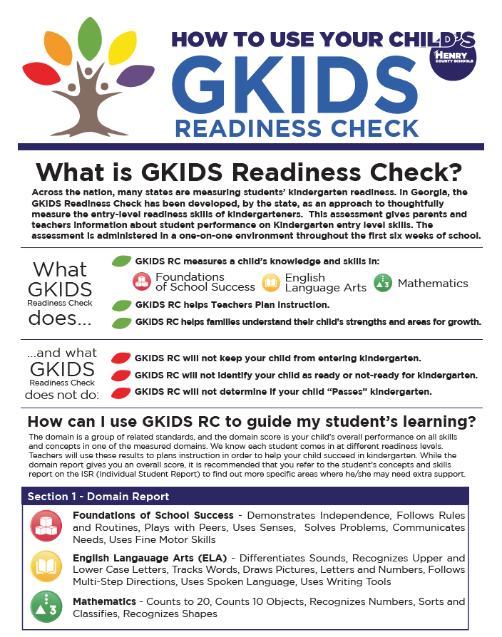
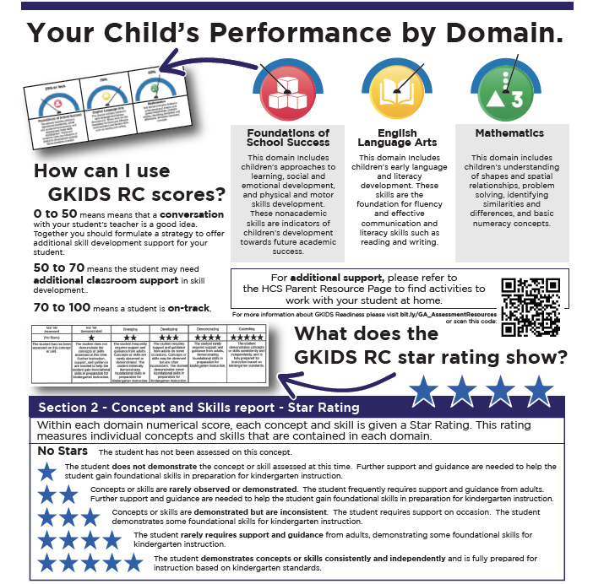
Parent Guide “How to Read the Report”

Slide 10
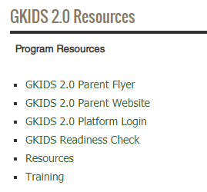
GKIDS Readiness Check Resources
GaDOE Website Link
https://www.gadoe.org/Curriculum-Instruction-and-Assessment/Assessment/Pages/GKIDS-2.0.aspx
Notes:
We have provided resources for both GKIDS and the Readiness Check which provide additional and detailed information. Taking some time to review these materials as well as participation in the training modules may serve to provide a better understanding of the formative nature of this assessment.

Slide 11

GKIDS Readiness Check Parent Website
gkidsparent.gadoe.org
  Provides guidance on understanding the Individual Student Report
  Offers activities aligned to the Big Ideas within each domain
  May be utilized during parent conferences
  Enhances school to home communication
Notes:
Another important resource is the GKIDS 2.0 parent website. The website provides guidance on understanding the individual student report, including a short video, as well as activities that may be completed at home to support students understanding of the big ideas within each domain. The website may be utilized during parent conferences and serves to enhance school to home communication.
Please visit the parent website at gkidsparent.gadoe.org

